Slide 1
Regression Project – PTDS 2403 Effect of CO2 Emissions on on Temperature
David Harrison (November 2024)

Slide 2
Overview
Our team of consultants have been tasked by a coalition of agricultural stakeholders to analyse and predict the effect of CO2 on climate change from emissions from the agri-food sector. We have been provided with emission data, as well as population data, compiled by the Food and Agriculture Organisation and the Intergovernmental Panel on Climate Change. This data spans the period 1990 to 2020 and covers nearly all areas across the world, providing emission data from 23 sources.
Climate change represented by shifts in temperature can have catastrophic impacts on our environment and future existence. Natural disasters, as can be seen in just the last few months appear to be on the increase. Certain crops require particular environments to thrive, and if these are threatened our food supply could be threatened.
Our aim through this project is to understand trends and through regression analysis identify the emission sources that are most likely leading to changes in the Average Temperature.

Slide 3
Overview
The data provided for the project represents emissions from the agri-food sector for the period 1990 to 2020, across 236 areas.
The data includes 23 sources of carbon dioxide emissions across these areas and the period above.
A population split between urban and rural and male and female is also provided.
The purpose of the project is to predict the annual change in temperate given specific data inputs.
We will attempt to review the various sources of emissions and population levels to understand what drives the change in temperature.
On closer inspection of the data we found that the figures for China have been duplicated into sub areas. Therefore we have removed the following data from the dataset: China (Hong Kong), China (Macau), China (mainland), and China (Taiwan); leaving the total represented by the entries for China

Slide 4
Initial Analysis of the Data
To understand the problem better and the contributing factors

Slide 5
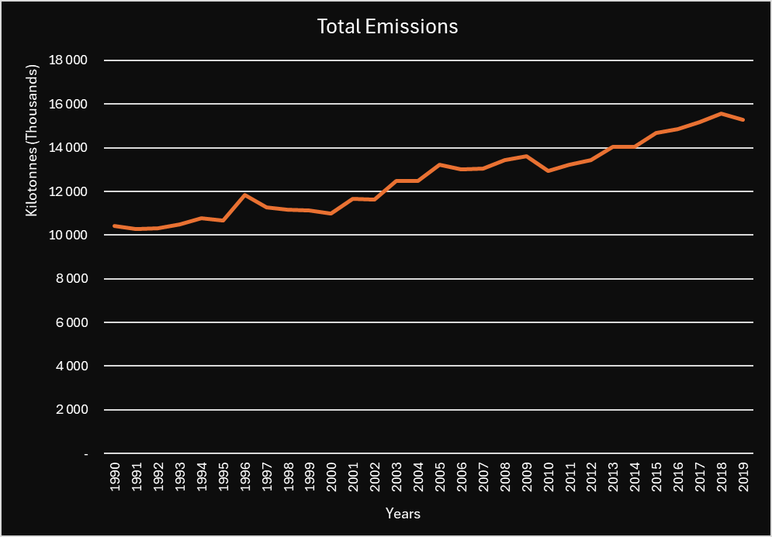
Total Emissions Trend
Total emissions have been steadily growing since 1990, (10.3m kilo tonnes), through to 2020, (15.3m kilo tonnes).
This is a growth of 49% over the period or a compounded annual growth rate of 1.3% each year

Slide 6
Total Emissions
China contributes 15% of the total annual average emissions.
They are followed by Brazil (9%), Indonesia (7%) and USA (6%)
These 4 countries alone account for 37% of emissions.

Slide 7
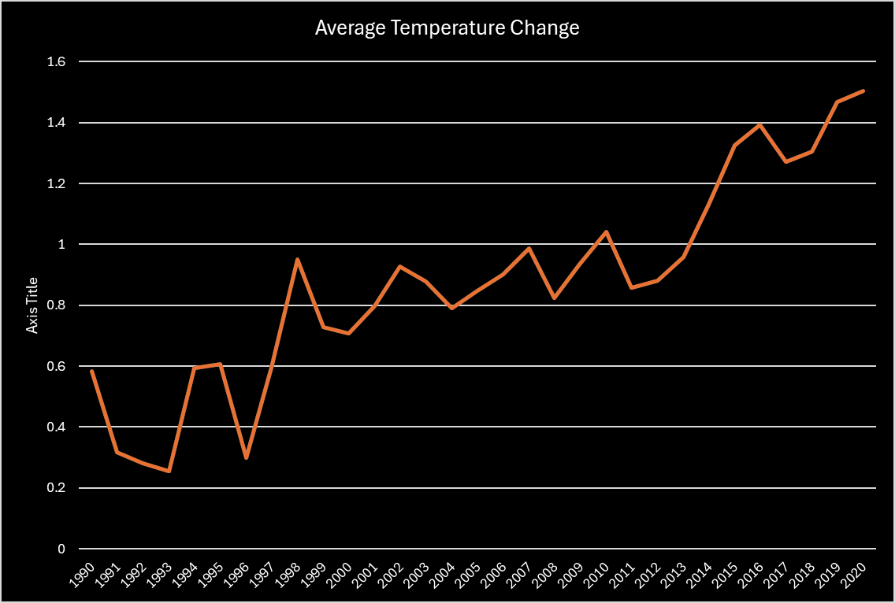
Average Temperate Change
Average annual temperate change over time follows the same trend as total emissions over time
1990 – 1997: yearly average temperature change was 0.44 degrees Celsius
1998 – 2013: yearly average temperature change was 0.88 degrees Celsius
2014 – 2020: yearly average temperature change was 1.34 degrees Celsius

Slide 8
Average Temperate Change
We averaged the change in temp over the period for each area and ranked areas in descending order of average temperate change
Interesting to note that the majority of the top 20 areas are in Europe

Slide 9
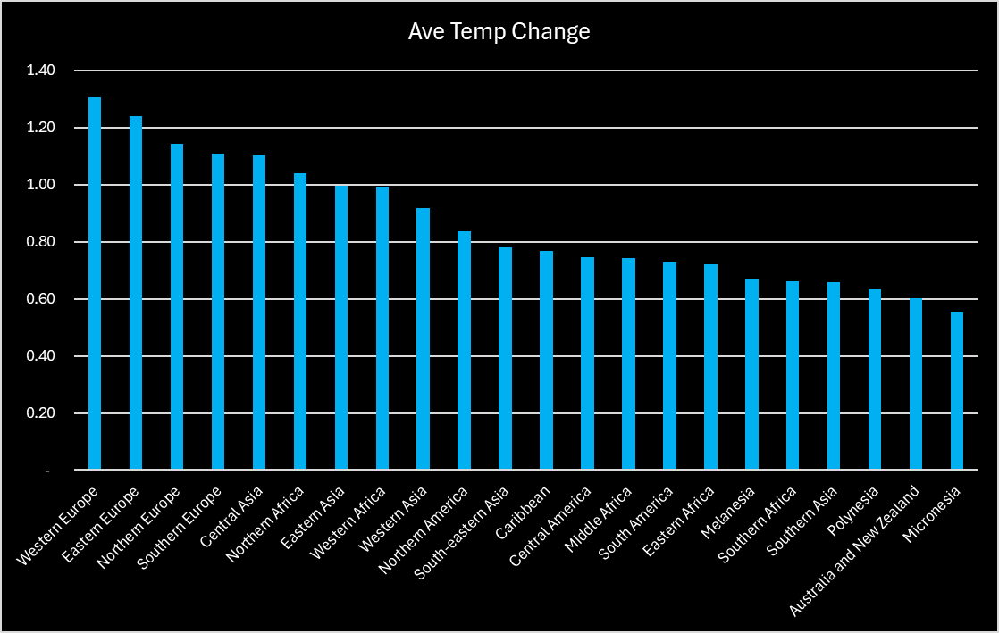
Average Temperate Change Regions
We used the United Nations Geoscheme mapping to map areas to regions.
Europe has seen the highest average temperature change (increase) over the period.
Europe however is not responsible for the highest emissions, as can be seen from analysis further down this pack

Slide 10
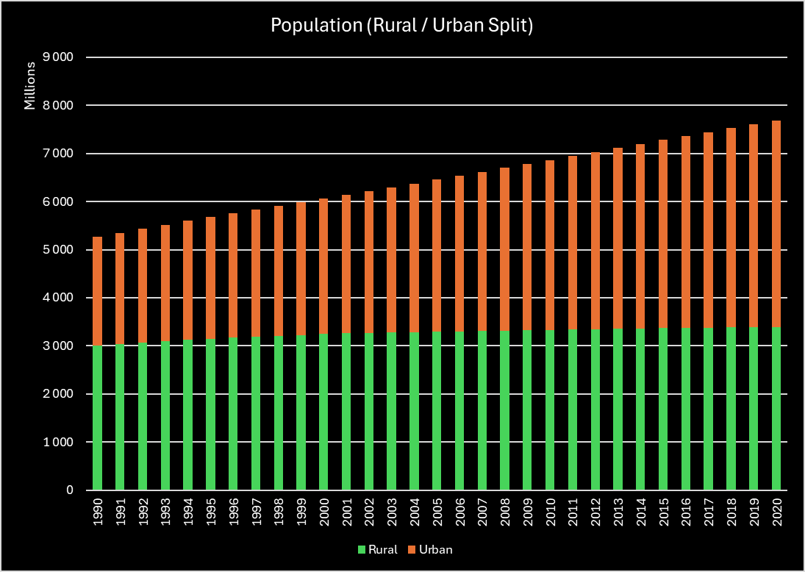
Population Split
Total population across the areas has grown from 5.3 billion to 7.7 billion, ( a 46% growth over the period)
This is a compound annual growth rate of 1.3%
The percentage of people living in urban areas has grown from 43% in 1990, to 56% in 2020
Interestingly these growth rates are very similar to total emissions. As the population grows, so does the need for food production.

Slide 11
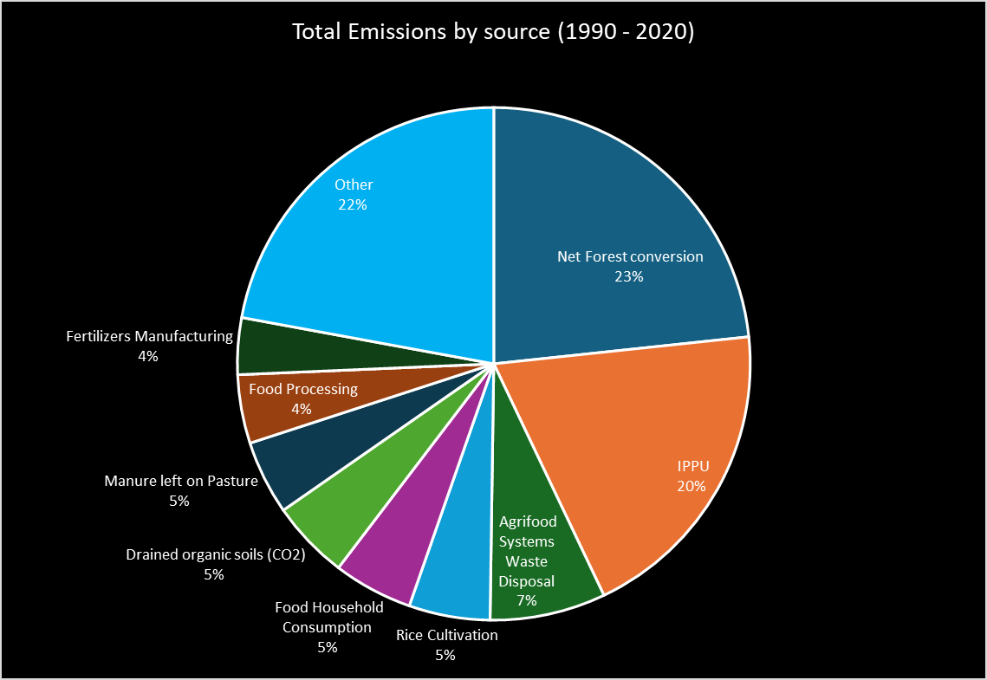
Emission Sources
The graph represents sources that add to CO2 emissions, therefore excludes Forestland
Net forest conversion, IPPU (Industrial Processes and Product Use), and Agrifood Systems Waste Disposal accounts for 50% of the CO2 emissions

Slide 12
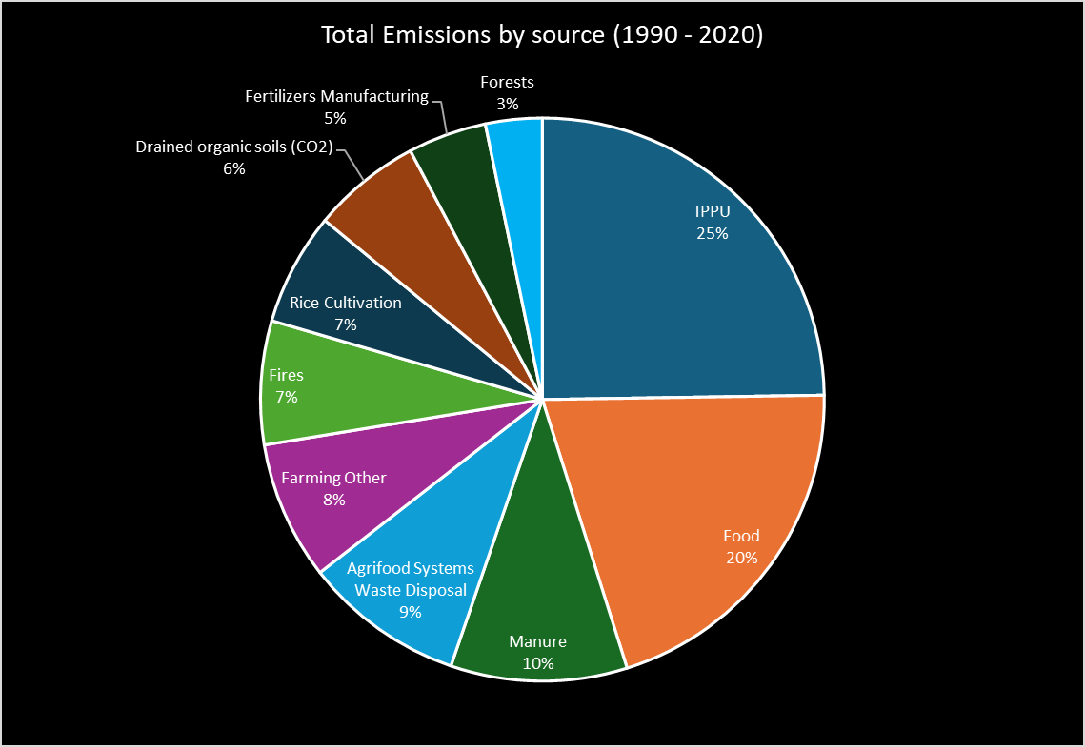
Emission Sources (Summarised)
We grouped the emission sources into logical groups.
On doing this Forests nets off to 3% of total CO2 emissions, because of Forestland providing a net off effect
IPPU, Food and Manure contribute to 55% of total CO2 emissions.
It would be interesting to see if the grouped features contributes to better predictions

Slide 13
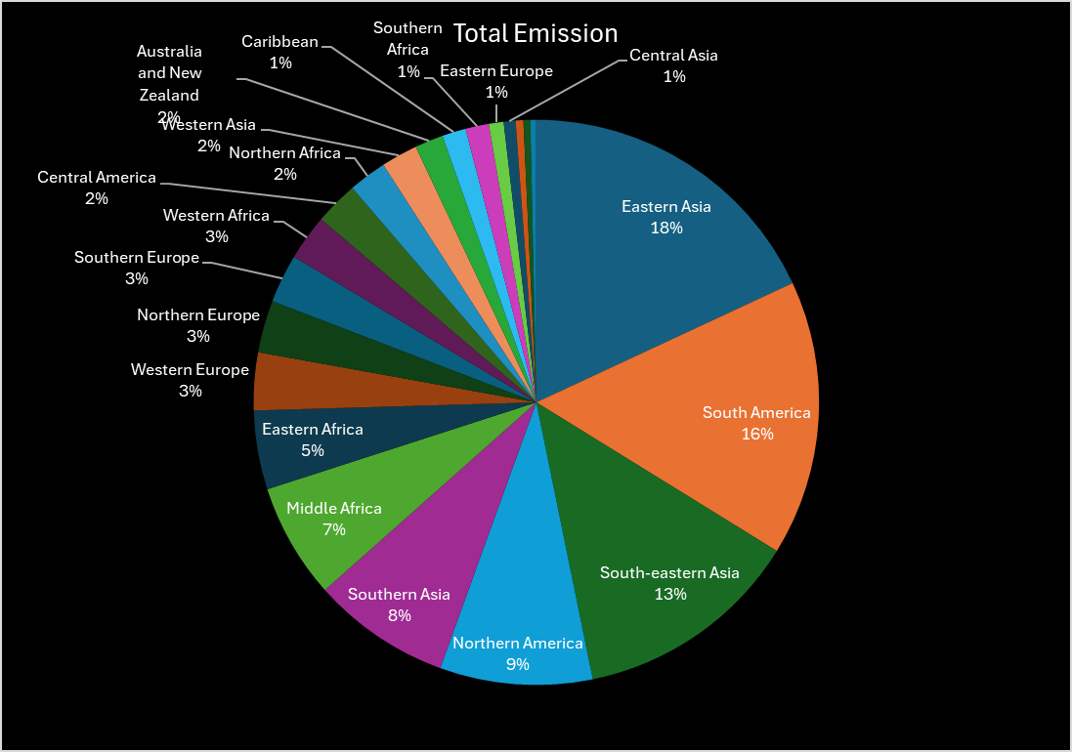
Emissions by Region
Using the United Nations Geoscheme mapping of areas to regions:
We can see that Asia and the America’s account for the greatest portion of total emissions, however Europe appears to be affected the most.
Global co-operation is required to bring about positive climate change going forward, as it appears that the behaviour in some areas are affecting other areas.

Slide 14
Exploratory Data Analysis

Slide 15
Data Cleaning
The dataset received, contains 6965 rows and 31 columns
We discovered that there were many null values, and we therefore replaced these nulls with zeros.
The individual emission sources added up to the total emissions for each row, so there was no data missing.
Models like linear regression cannot run with null values.
We further discovered that the data for China was duplicated. One row for the total and 4 rows for the regions within China. The regional China data was removed from the dataset.
Other than the above there were no further duplicate rows.

Slide 16
Data Sets Used
Below are the data sets used and referred to going forward in this analysis.
Filtered Data: this dataset is the full dataset with the various China regions removed: China (Hong Kong), China (Macau), China (mainland), and China (Taiwan)
6841 rows and 31 columns
Grouped by Region: using the United Nations Geoscheme mapping, we used the filtered data set and mapped the areas into regions and summarised the data
680 rows and 31 columns
Group by Year: using the filtered data set, we summarised the data by year
31 rows and 30 columns
Aggregated: aggregated like emission sources, to summarise by emission source
6841 rows and 15 columns

Slide 17
Filtered Data (analysis)
Rows and columns
On looking at the basic statistical measures using the describe function in python, it was discovered the mean of many features fell in the 75% to 100% quartile
The data is highly positively skewed, with kurtosis values greater than 3, indicating many outliers.
Density subplots confirmed this visually
Correlation analysis between the various features and the target variable, Ave Temperature Change, is very weak other than for Year. (Which we saw in the initial analysis.)
A heatmap of the correlation matrix produced in python showed much multi-collinearity between the features.

Slide 18
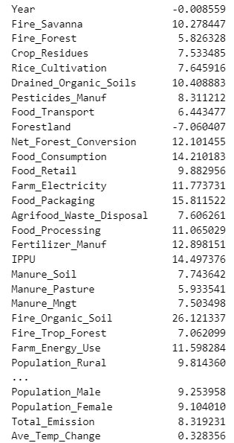
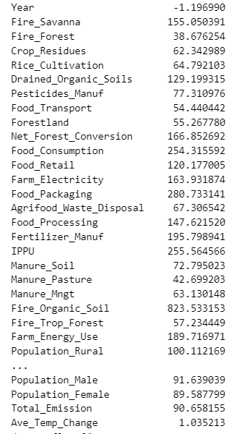
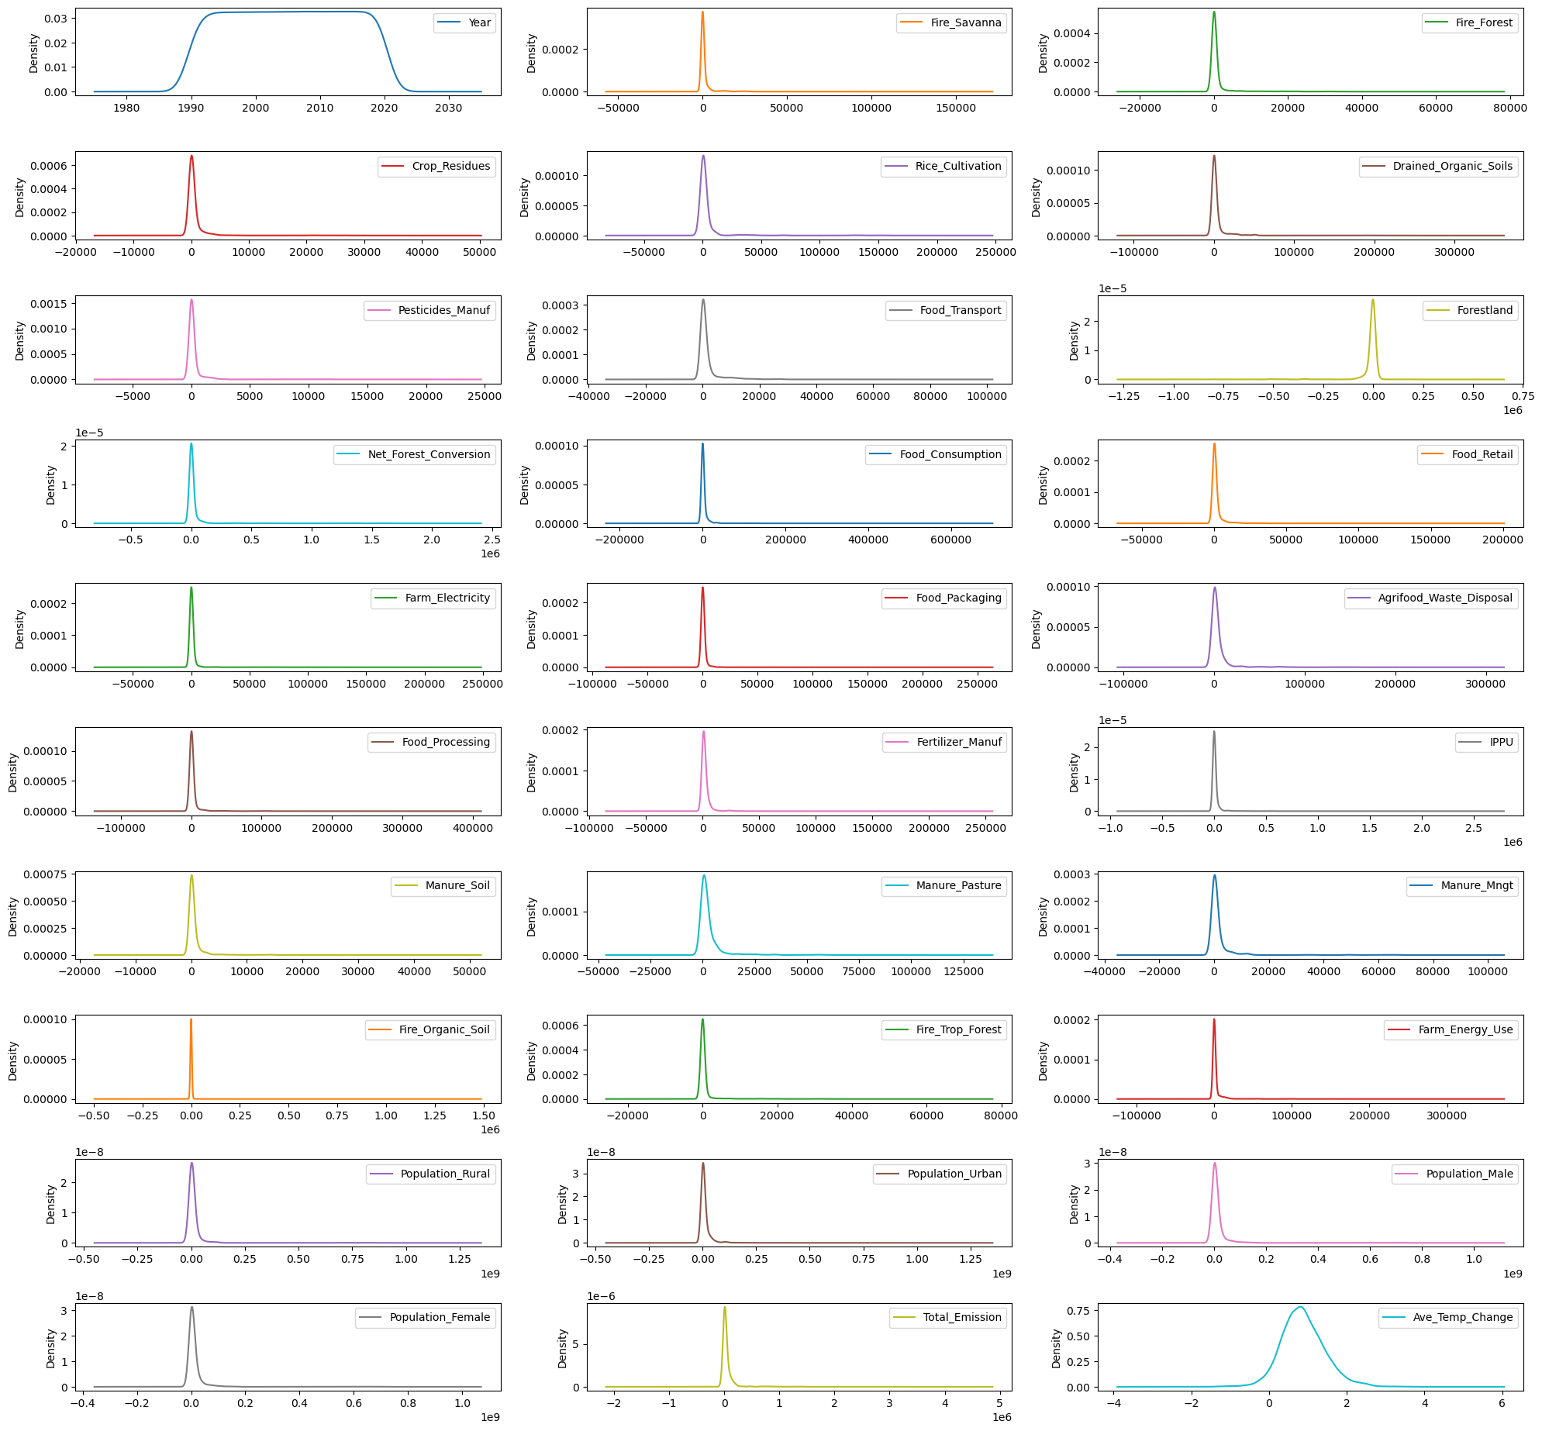
Filtered Data (analysis)
Skewness:
Kurtosis:
Density Plots:

Slide 19
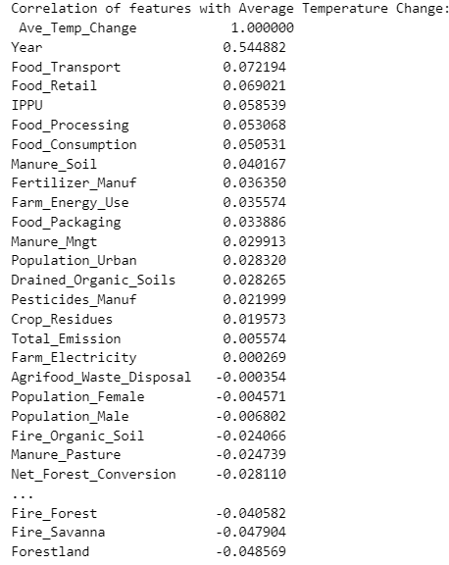
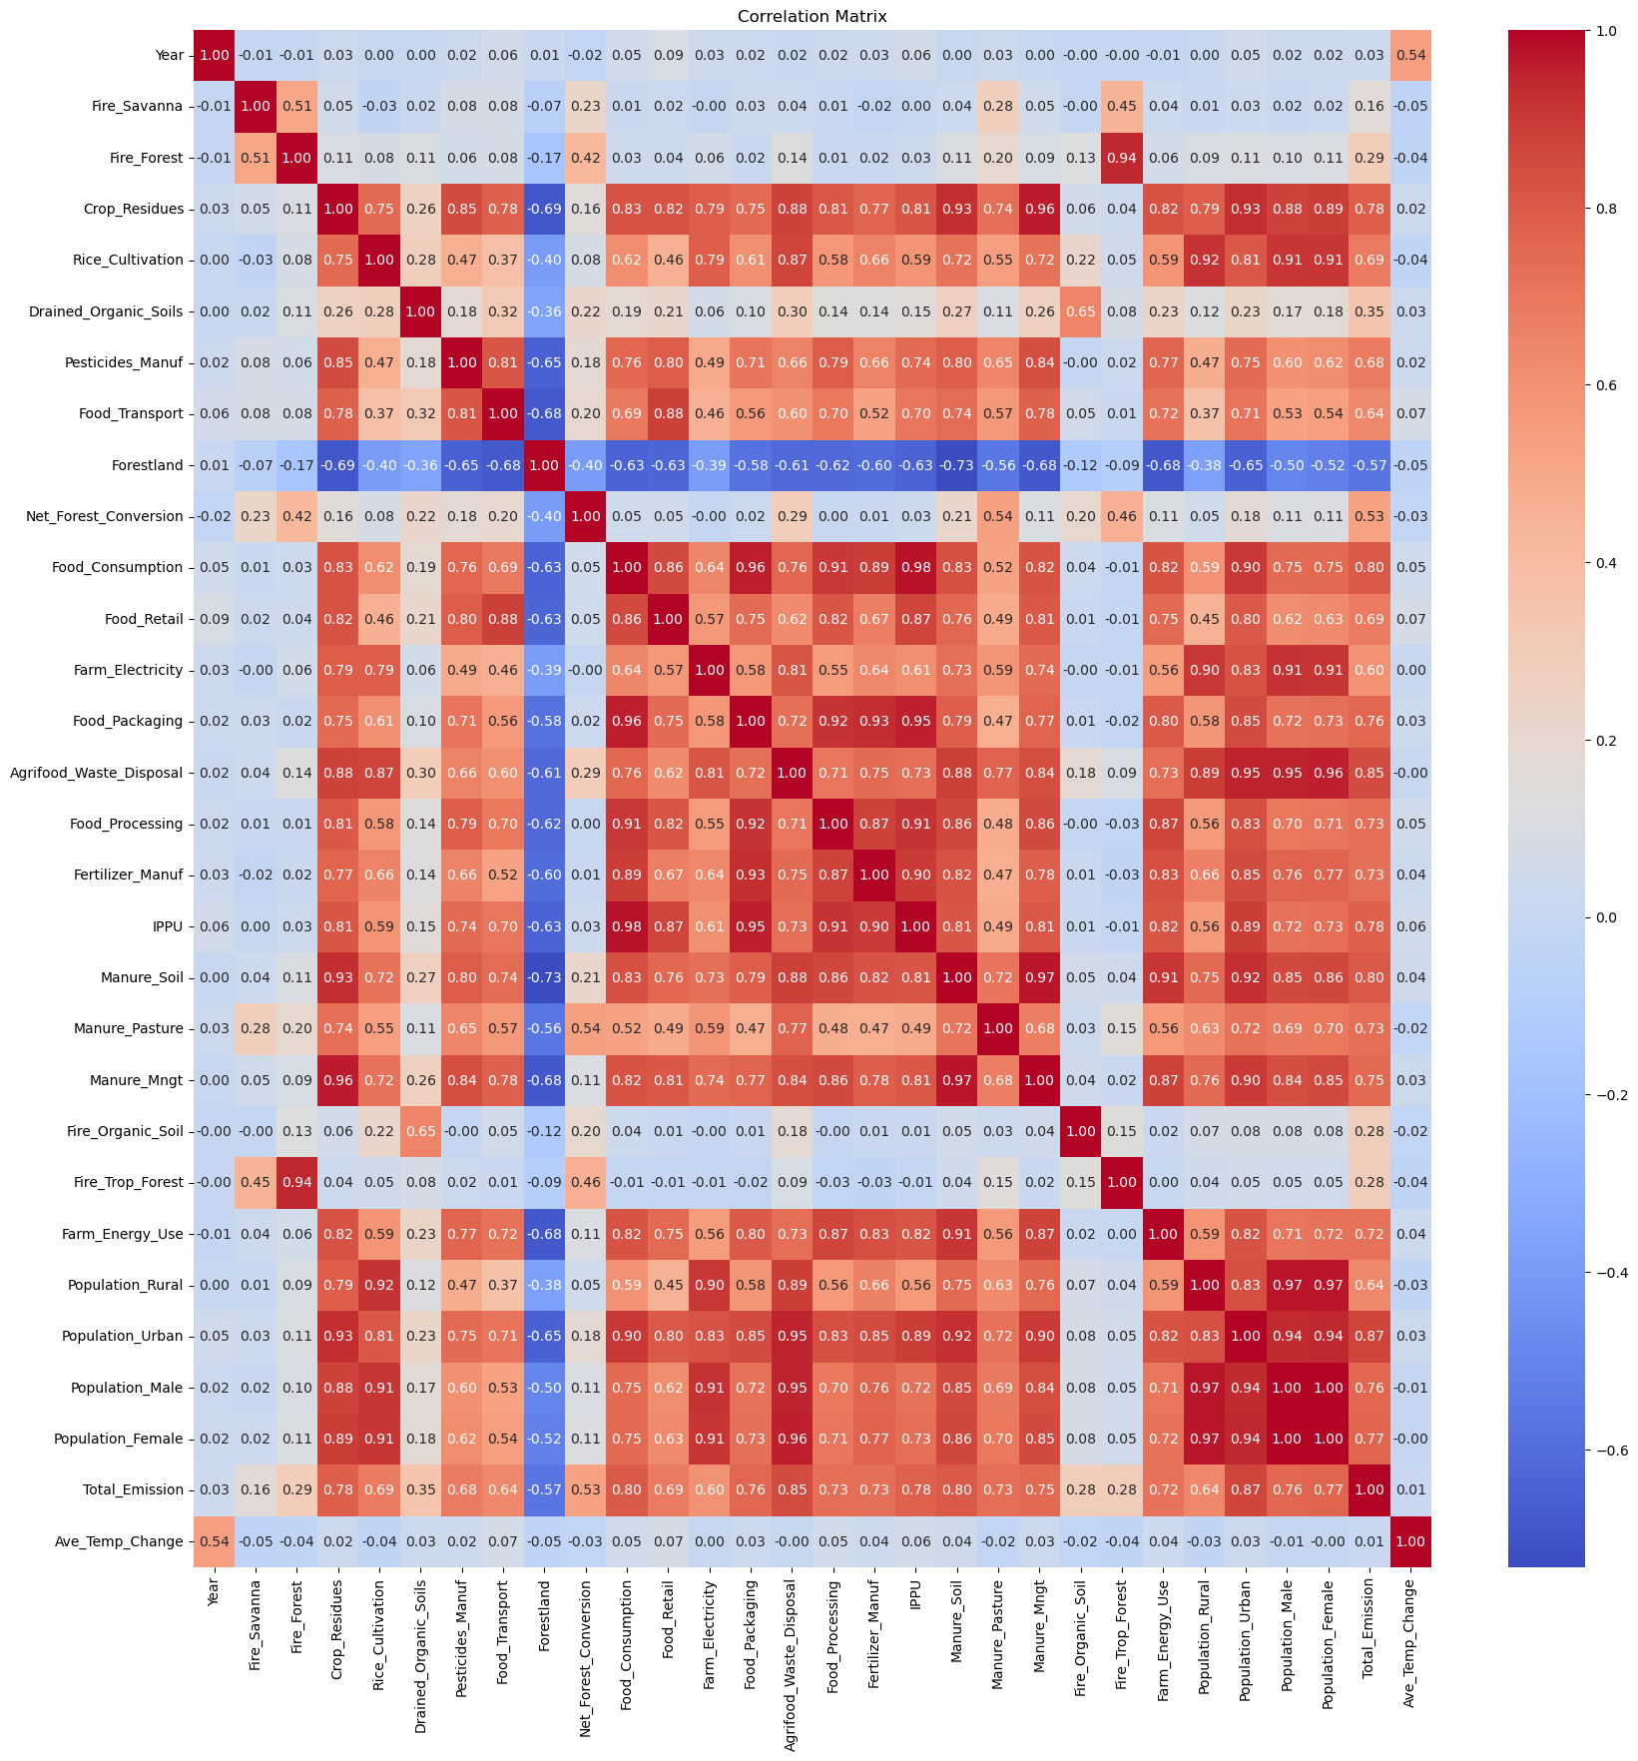
Filtered Data (analysis)
Correlation:
Heatmap:

Slide 20
Grouped by Region Data (analysis)
680 rows and 31 columns
The data is distributed better than before grouping by region
The data is still positively skewed, but the values are lower. Density subplots confirm slightly better distribution.
Correlation analysis between the various features and the target variable, Ave Temperature Change, is higher than for the ungrouped data. Other than year the highest correlation is with Food Retail, but at 27% is still quite weak.
A heatmap of the correlation matrix produced in python still showed much multi-collinearity between the features.

Slide 21
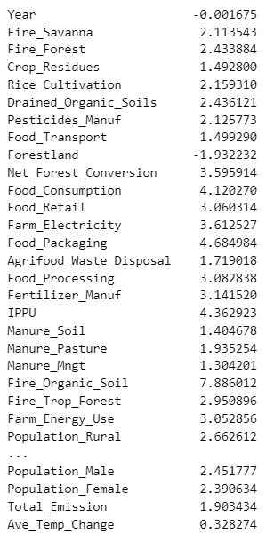
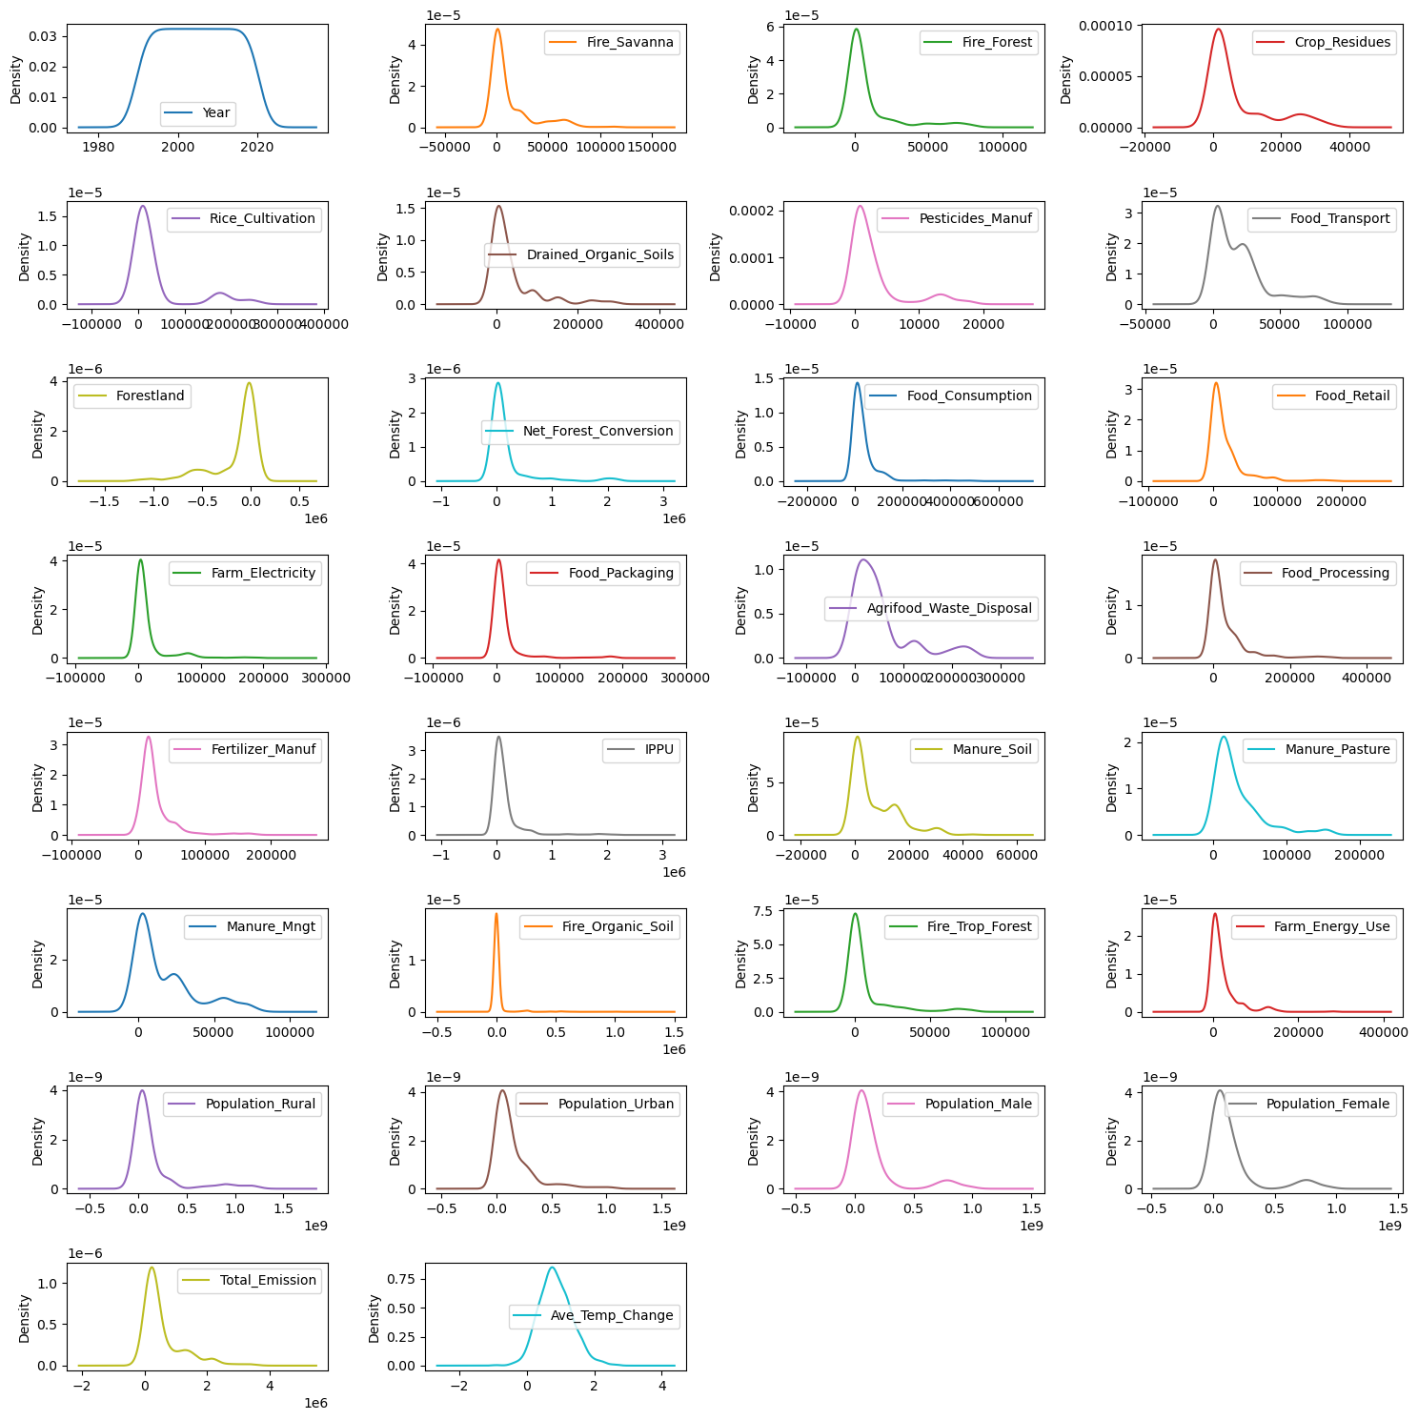
Grouped by Region Data (analysis)
Skewness:
Density Plots:

Slide 22
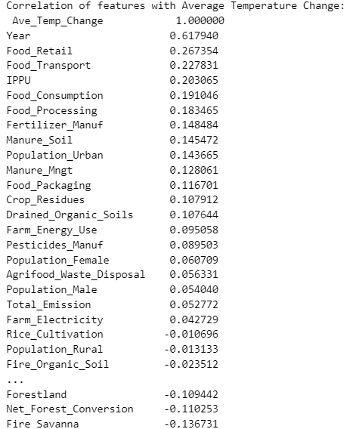
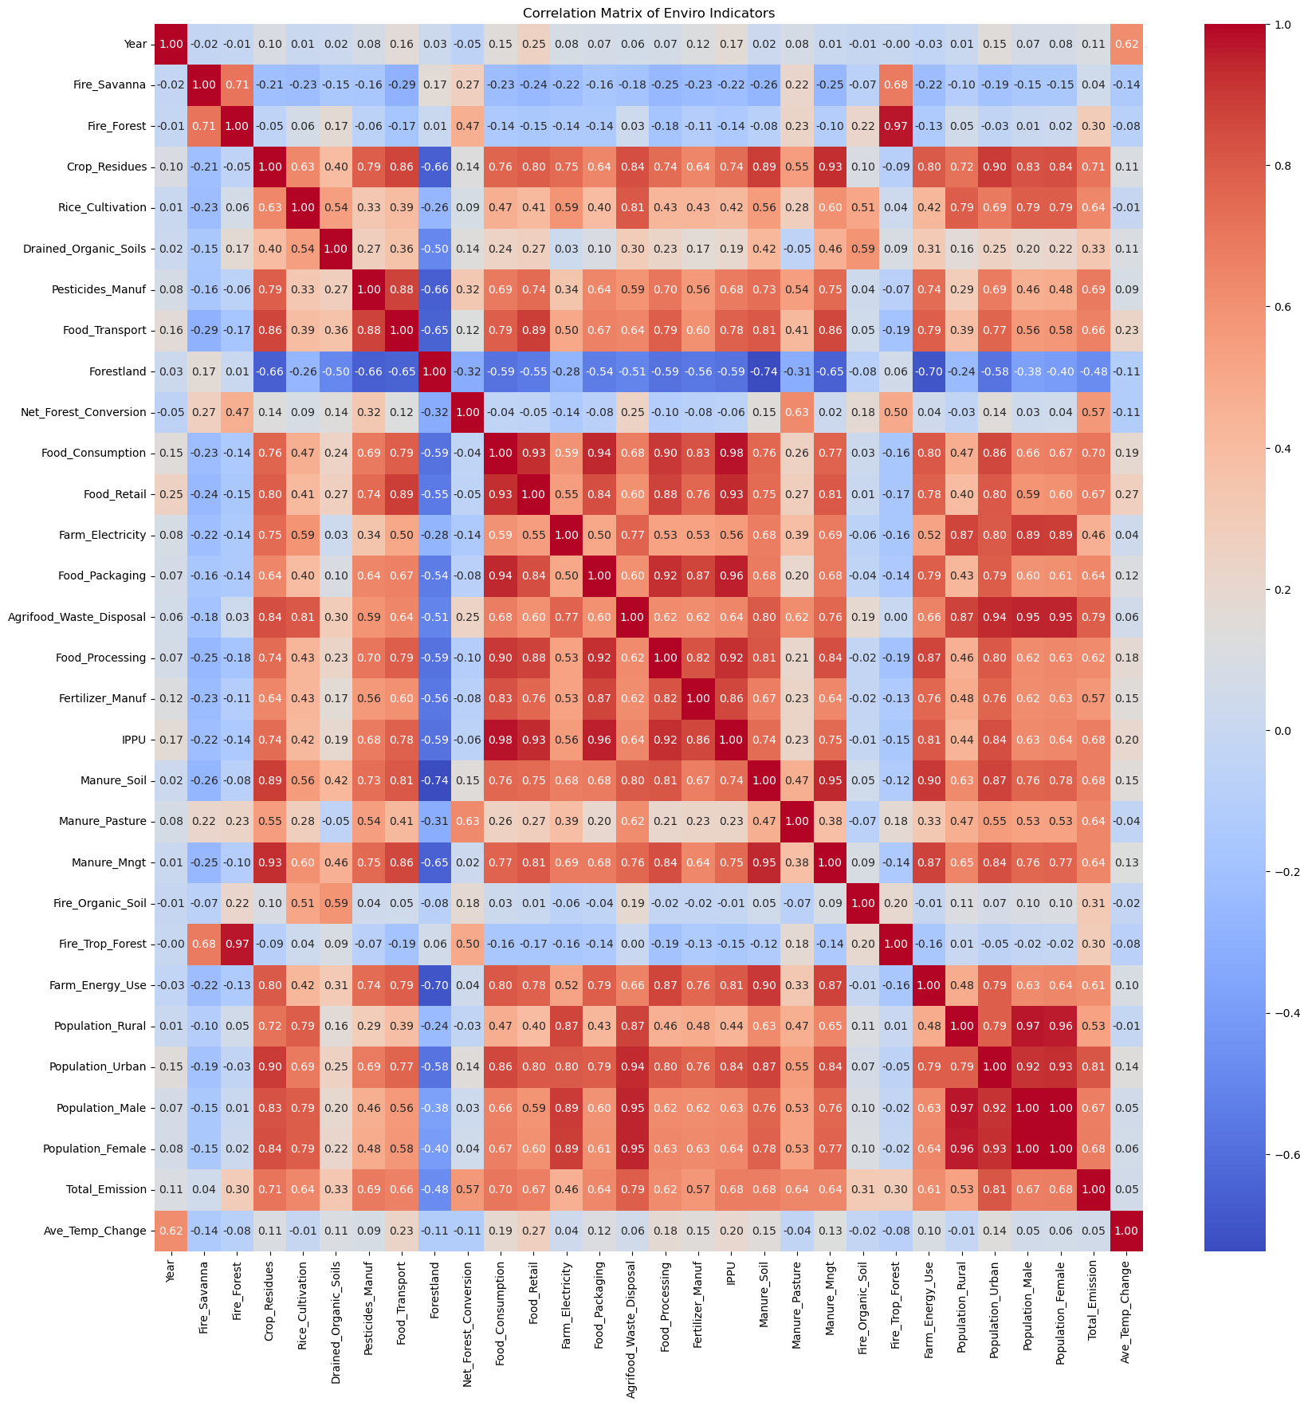
Grouped by Region Data (analysis)
Correlation:
Heatmap:

Slide 23
Regression Models Applied
It was decided to drop the year & total emission features from the dataset. From external analysis we know that emission levels have increased over time and that the Average Temperature Change has been becoming greater with time, however we don't want time to be the predicting factor of change. We are trying to find the emission sources that are contributing most to Average Temperature change so that we can effect future environmental policy. Total Emission is the total of all the emission sources and is not going to tell us either which source contribute to temperature change.

Slide 24
Multiple Regression
Filtered Data:
Trained a multiple regression model with the filtered data, applying no parameters
Results:
R2 score = 0.0254
MSE = 0.299
RMSE = 0.542
MAE = 0.422
Grouped by Region:
Trained a multiple regression model with the grouped by region data, applying no parameters
Results:
R2 score = 0.110
MSE = 0.181
RMSE = 0.425
MAE = 0.329

Slide 25
Multiple Regression
The multiple regression models perform badly and are hardly able to explain changes in the target variable with very low r-squared scores
The root mean square scores mean that predications can be 0.4 to .5 degrees Celsius off

Slide 26
Lasso
We first performed a lasso with cross validation on the filtered data set in order to get the optimal alpha value, which is 0.0006. We applied this alpha value as a parameter for the 2 lasso models
Filtered Data:
Results: (the model used 21 features)
R2 score = 0.025
MSE = 0.294
RMSE = 0.543
MAE = 0.422
Grouped by Region:
Results: (the model used 26 features0
R2 score = 0.104
MSE = 0.182
RMSE = 0.427
MAE = 0.336

Slide 27
Lasso
Both models did not really perform any better than their counterparts when using the multiple linear regression method, in fact slightly worse

Slide 28
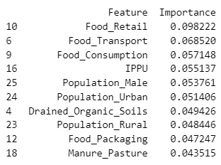
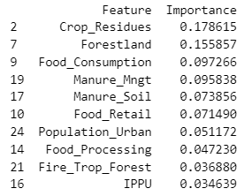
Decision Trees
Because of the high multi collinearity in the data is was decided to set the splitter parameter to random, and the minimum samples per leaf to 5
Filtered Data:
Results: Top 10 features:
R2 score = 0.322
MSE = 0.205
RMSE = 0.452
MAE = 0.336
Grouped by Region:
Results: Top 10 features:
R2 score = 0.323
MSE = 0.137
RMSE = 0.370
MAE = 0.281

Slide 29
Decision Trees
Both decision tree models performed better than the multiple linear regression and lasso models
R-squared scores jumped to 0.32, meaning that 32% of the variance in the temperature change can be explained by changes in the emission sources
Root mean squared error also improved to 0.33 and 0.28, with the decision tree model based on the regional data outperforming the filtered data
In the top 5 features both shared food consumption as a notable predictor
The decision tree based on filtered data had predictors mainly concentrated around the industrial side and end product of the agri-food sector: food retail, consumption & transport, together with Industrial Processes and Products
The decision tree based on regional data however mainly concentrated on source issues like Forestland, crop residues, manure management and food consumption

Slide 30
Random Forests
Because of the high multi collinearity in the data is was decided to set bootstrapping to true and the minimum samples per leaf to 5
Filtered Data:
Results: Top 10 features:
R2 score = 0.483
MSE = 0.156
RMSE = 0.395
MAE = 0.292
Grouped by Region:
Results: Top 10 features:
R2 score = 0.377
MSE = 0.126
RMSE = 0.356
MAE = 0.267

Slide 31
Model Performance compared
The grouped by region models consistently performed better than their filtered data counterparts.
Performance improved significantly on using decision trees
Random forests outperformed all models
The best performing model being the grouped by region random forest

Slide 32
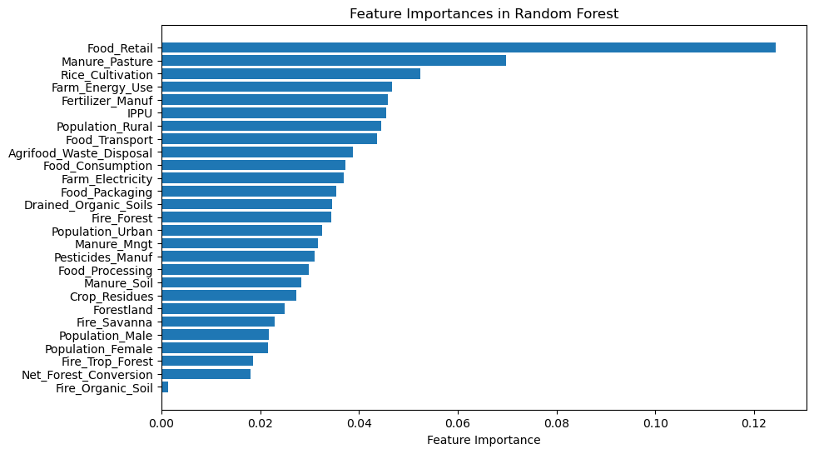
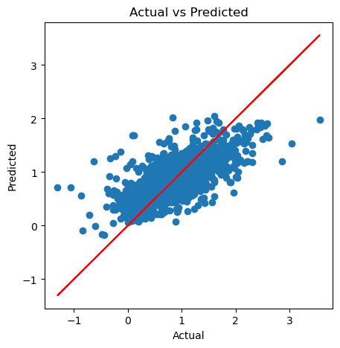
Evaluation of the 2 random forest models
Random forest on filtered data:
The most important features are food retail and manure pasture
Actual vs predicted values

Slide 33
Evaluation of the 2 random forest models
Random forest on filtered data:
We ran a cross validation exercise against this model and it performed poorly
Mean MSE was 0.285 compared to 0.16 on the training model

Slide 34
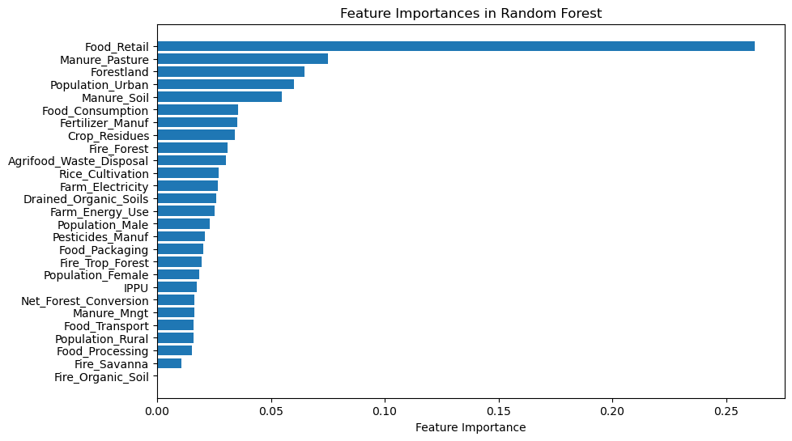
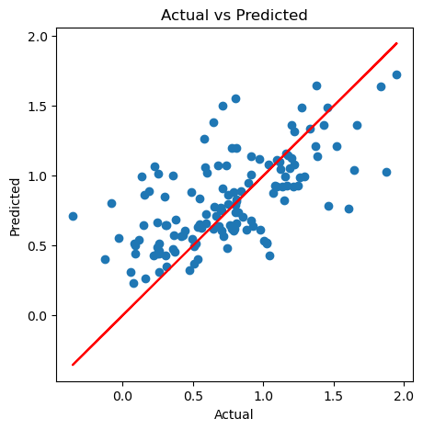
Evaluation of the 2 random forest models
Random forest on grouped regional data:
Food retail takes on even more importance than before, still followed by manure for pastures
Actual vs predicted values

Slide 35
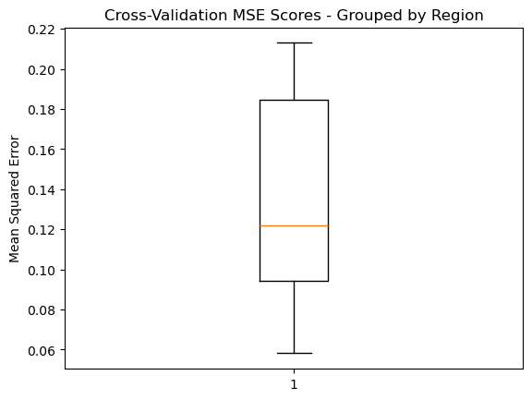
Evaluation of the 2 random forest models
Random forest on grouped by region data:
We ran a cross validation exercise against this model and it performed well
Mean MSE was 0.135 compared to 0.126 on the training model – the results on unseen data are consistent with the training data
The standard deviation of the mean MSE is 0.052 suggesting that the model performs consistently
Box and whisker of the MSE cross validation:

Slide 36
Conclusion

